Slide 1
Automated data extraction from 3D bar chart images
Jinho Lee, Jinhwan Sul, Myeonghyeon Song, Tackmin Kim
Notes:
Hi everyone. I'm jinho Lee.
Let me start our presentation of Automated data extraction from 3D bar chart images
Our project topic is Automated data extraction from 3D bar chart images. Let's begin!

Slide 2
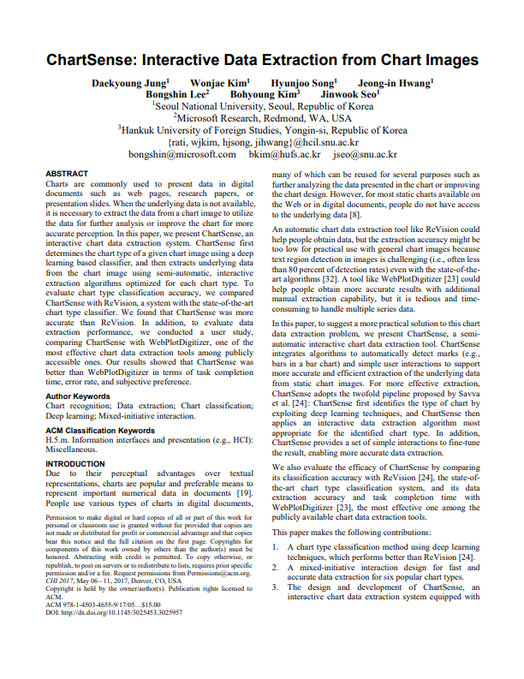
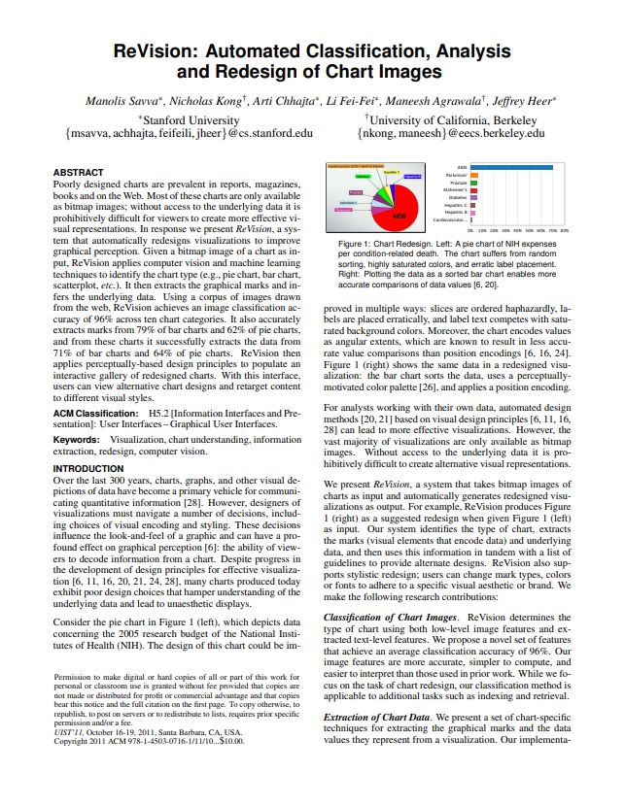
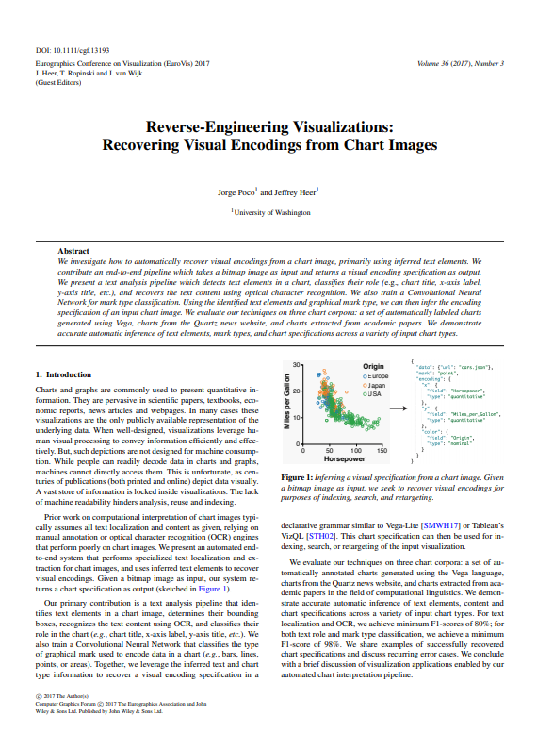
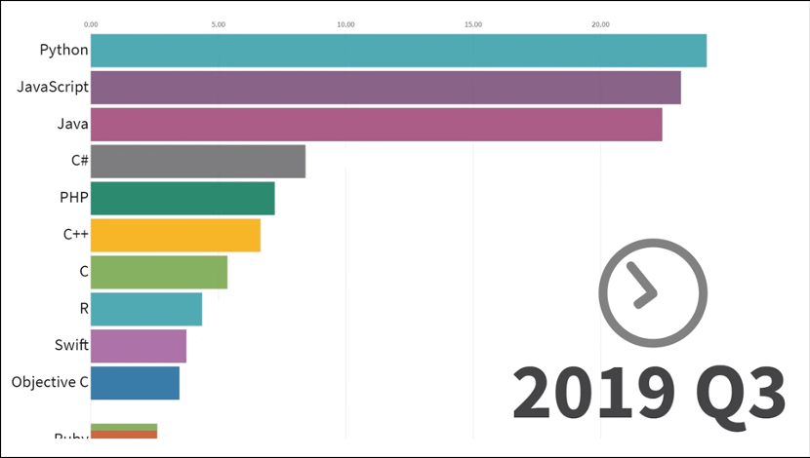
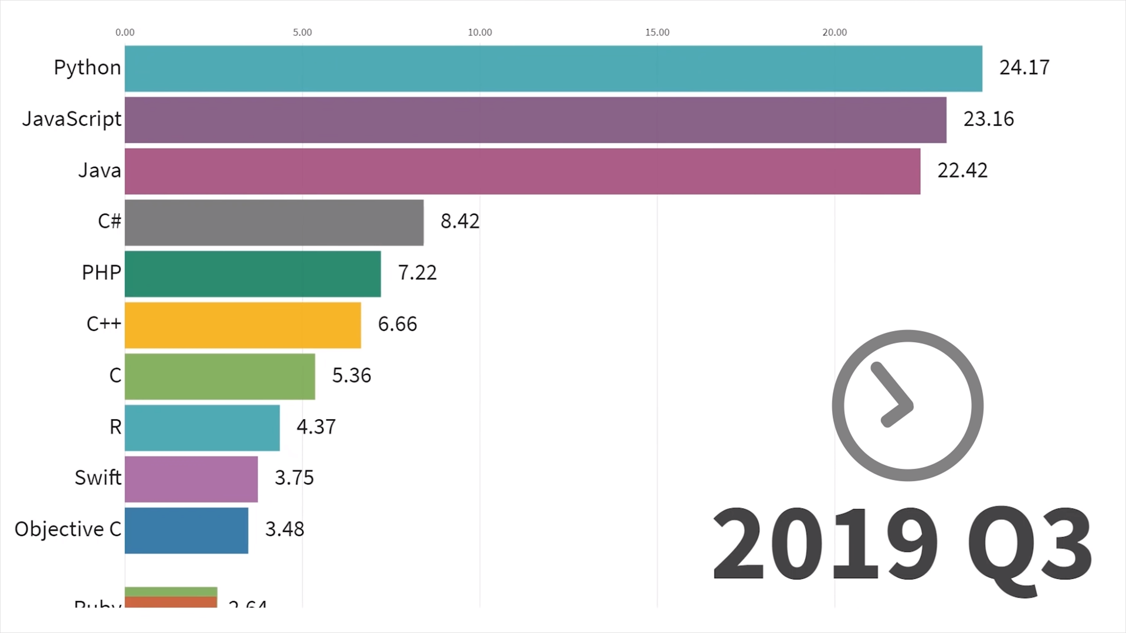
Project idea
The most popular programming languages in 2019
Let’s extract data from 3D charts!
Depends on human interaction
Dataset is limited
to 2D charts
Dataset is limited
to 2D charts..
Notes:
Chart is a good visualization tool, but sometimes we need the underlying data.
There were some studies which tried to extract data from the chart,
but most of them relied on human interaction and the dataset was limited to only 2D charts.
In this project, we will focus on extracting data from 3D charts automatically.

Slide 3
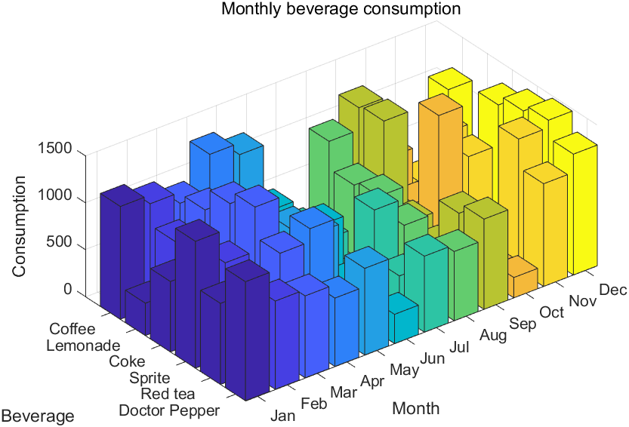
Reading data from 3D bar chart is difficult
Notes:
So this is an example of 3D bar chart. Actually, reading data from 3D bar chart is hard, even for human.
It requires projection of the top face of the bar to each axis.
Also there can be occluded data.
Because of these two reason, extracting data from 3D bar chart is very challenging

Slide 4
Reading data from 3D bar chart is difficult
Require projection to each axis
Occluded
data
Notes:
So this is an example of 3D bar chart. Actually, reading data from 3D bar chart is hard, even for human.
It requires projection of the top face of the bar to each axis.
Also there can be occluded data.
Because of these two reason, extracting data from 3D bar chart is very challenging

Slide 5
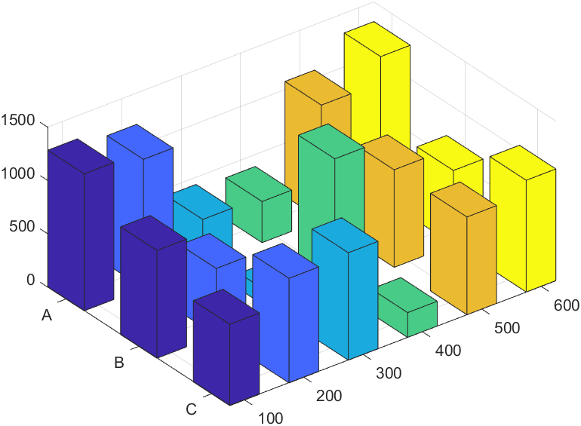
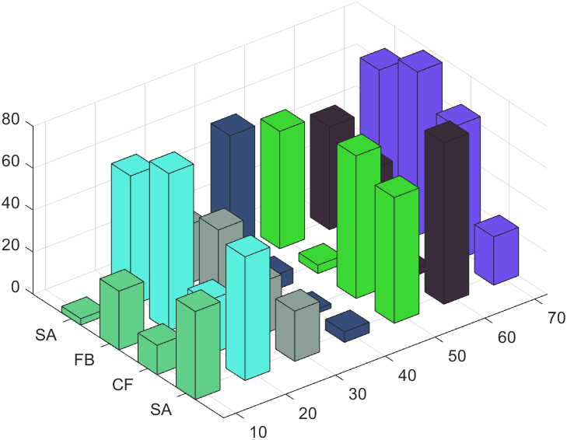
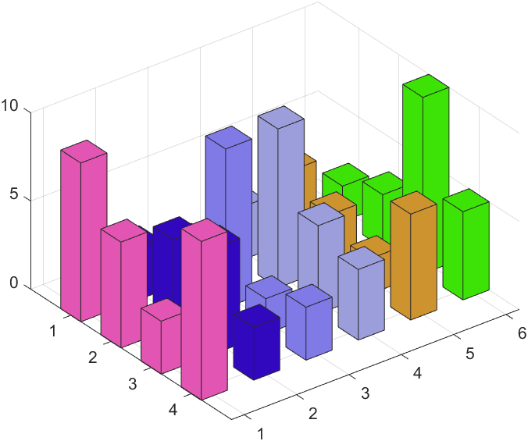
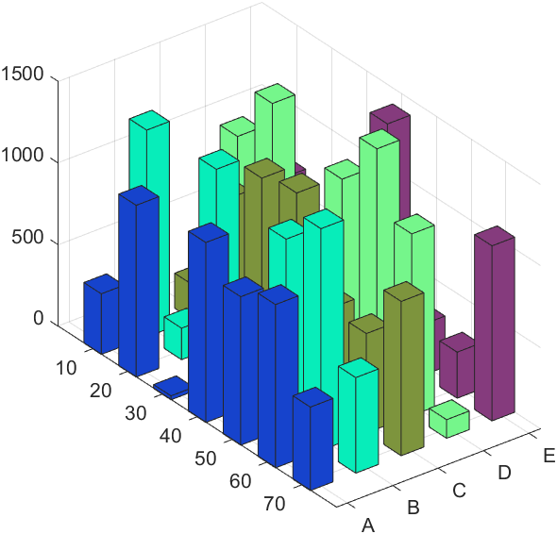
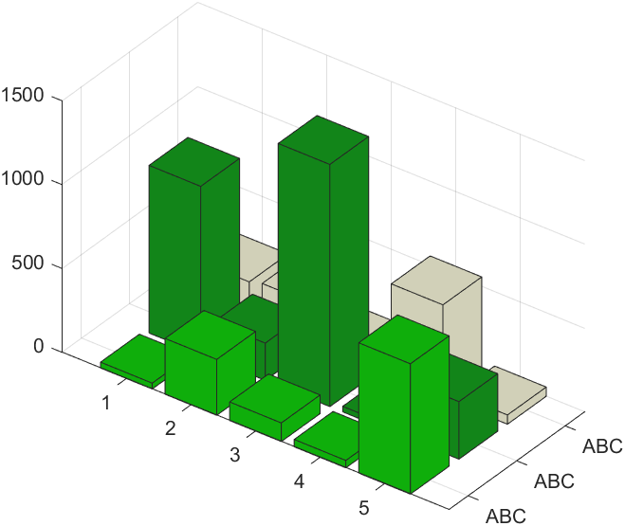
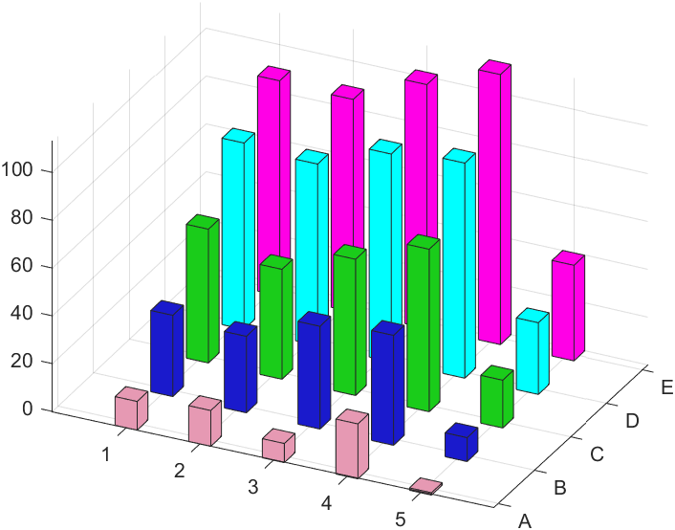
Dataset & Assumption
Dataset
3D bar charts generated from MATLAB.
Assumption
1. Axes and labels are well defined and easily noticeable
2. Orthographic projection
3. Bars stands vertically, not horizontally
4. Each series of bars have distinct colors
5. Auxiliary lines are parallel to the axes
Notes:
Next thing is dataset and assumption.
We used 3D bar charts generated from MATLAB.
We made five assumptions based on the characteristics of MATLAB images, as shown here.

Slide 6
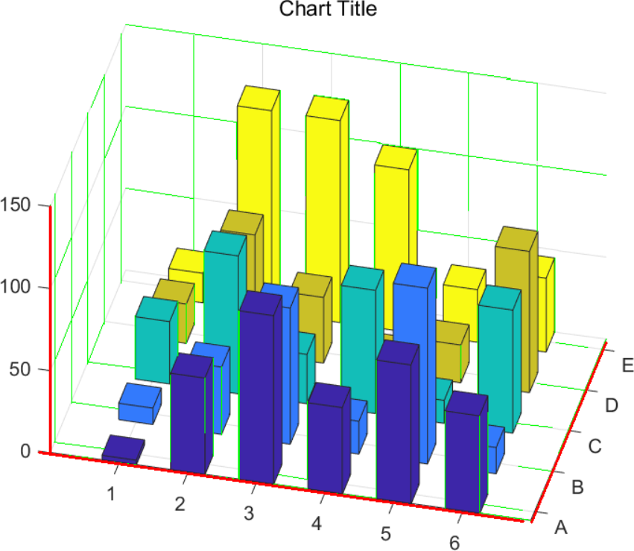
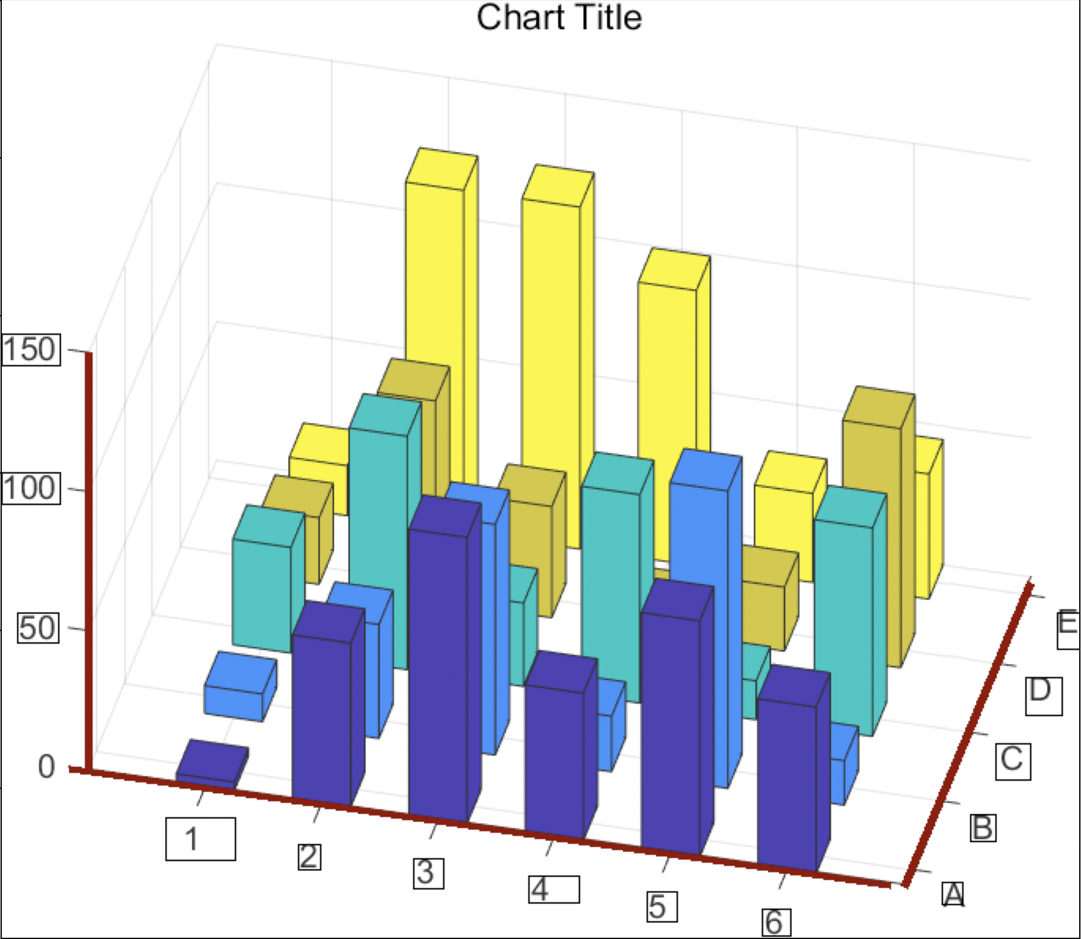
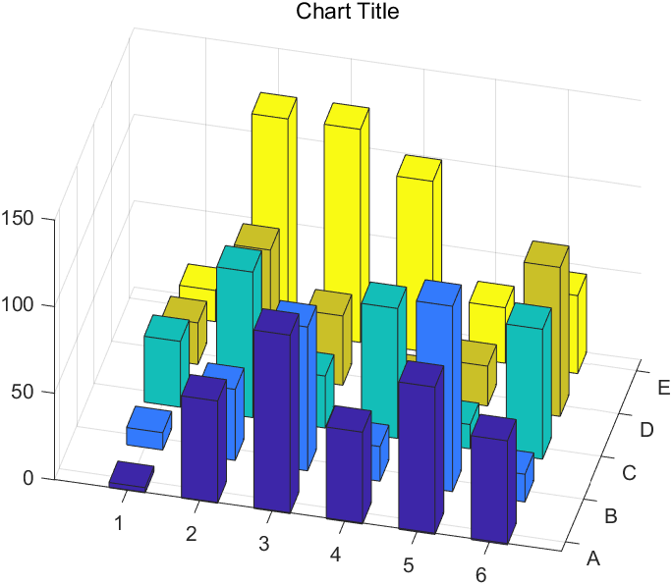
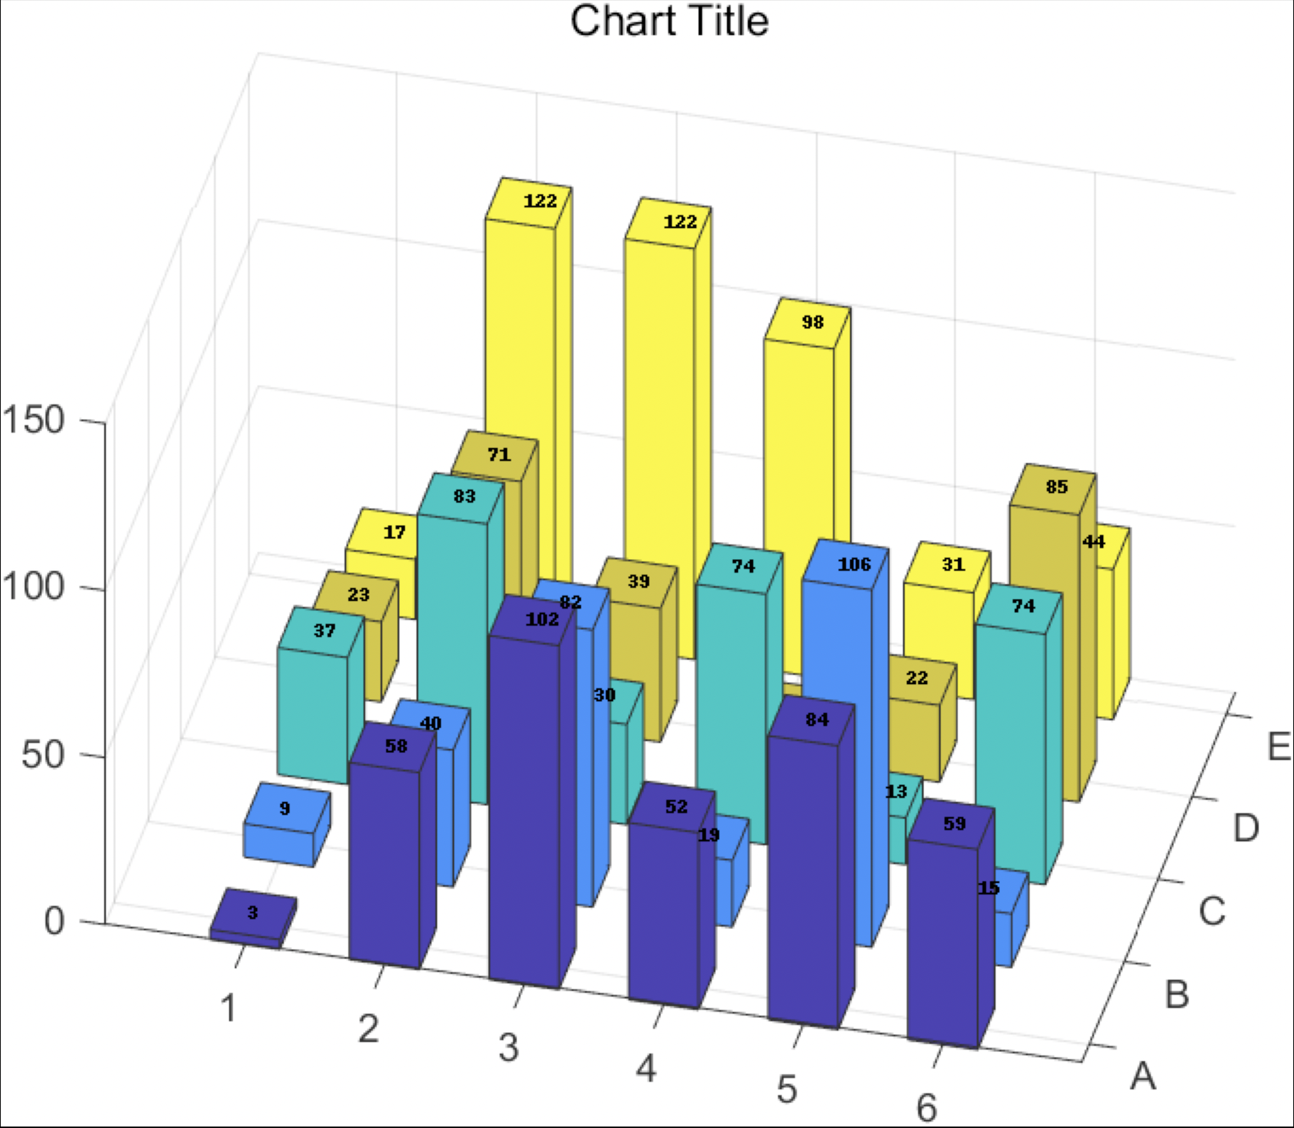
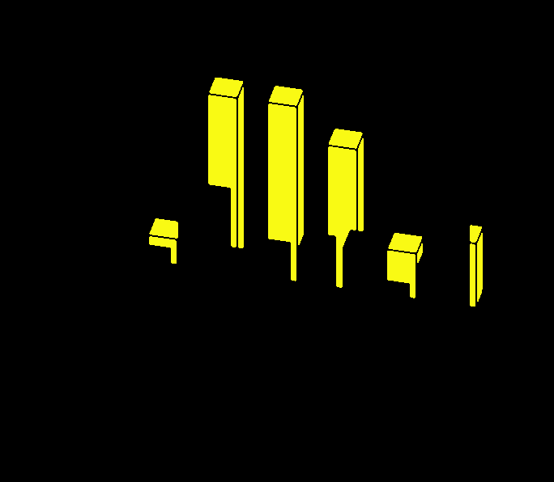
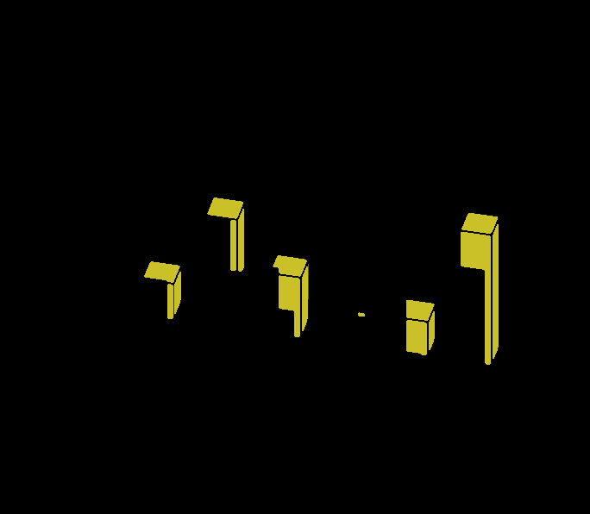
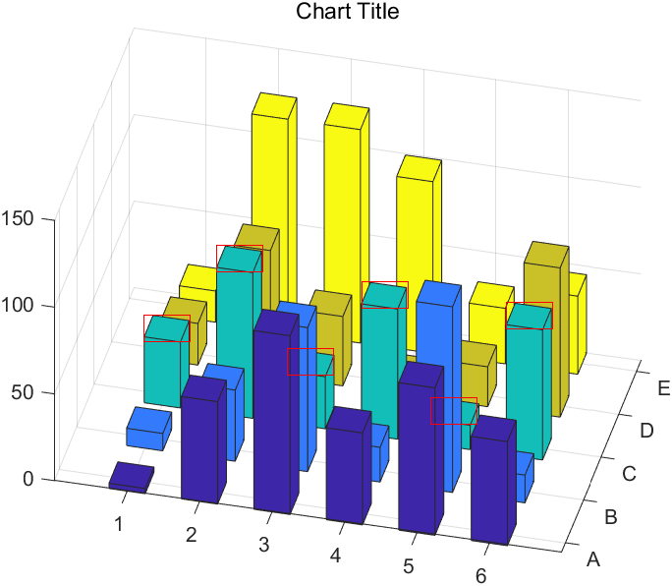
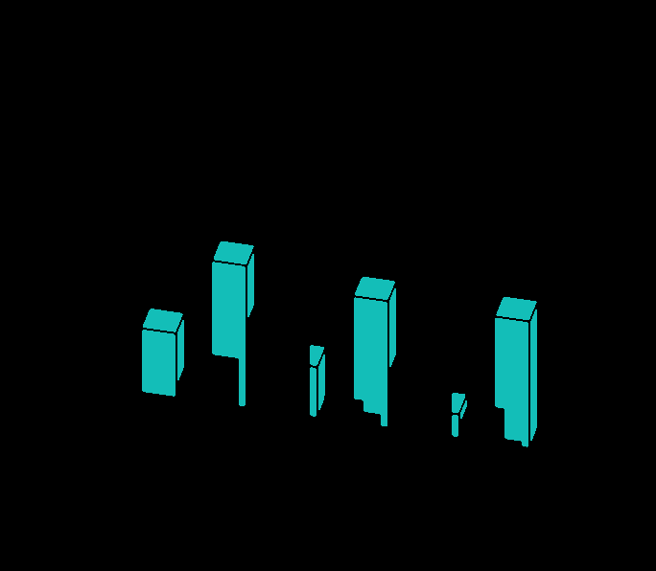
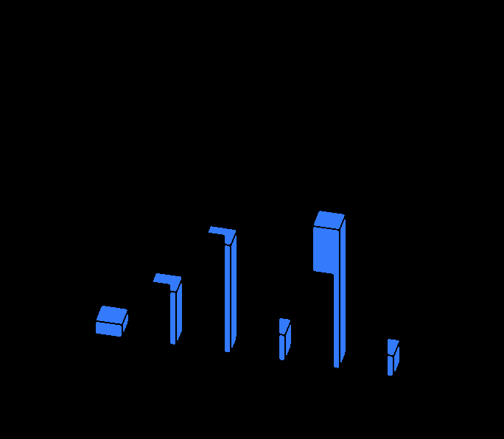
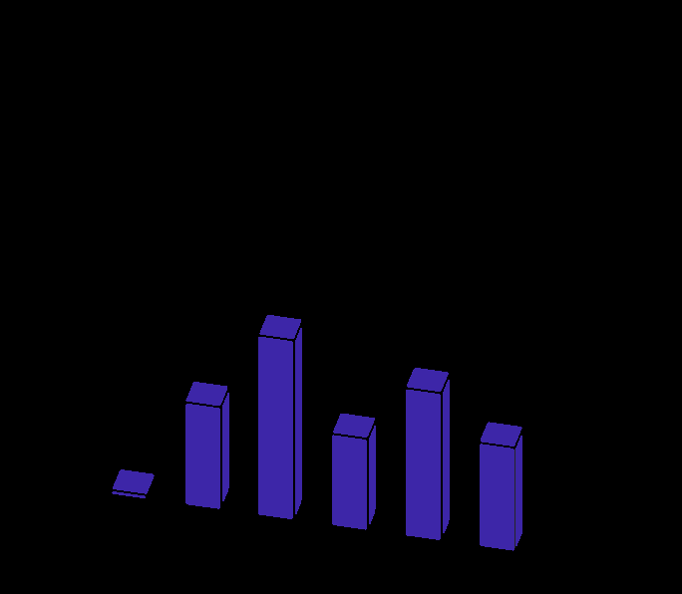
Automated data extraction from 3D bar chart
Find axes
Read labels
match tick to value
3D bar chart image
Extract data
Separate series with colors
Find head of bars
Notes:
This is the flow chart of our algorithm.
First it finds axes. After that using the location of axes, it reads the labels and match tick to value.
Also it seperates the bars with colors using HSV information and find heads of bars.
Using all these information, finally extract the data from the chart.

Slide 7
Find the axes
Goal
Find the x, y, z axis
Return values
Coordinates of each edges
the degrees of each axis
90 °
68 °
-8 °
Notes:
I'll explain each step in more detail.
The first step is finding the the x, y, z axis location.
Because the location of axes is used in the following steps, it is very important to detect them correctly.
It finds the coordinates of start and end point of each edges and the degrees of each axis.

Slide 8

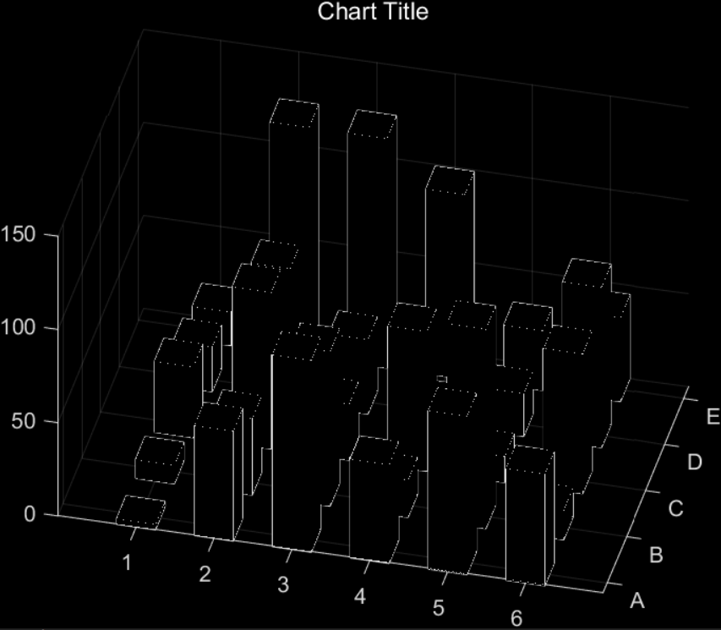
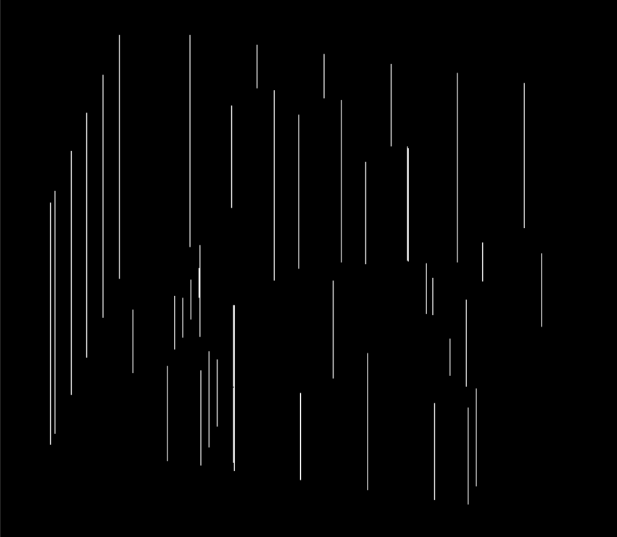
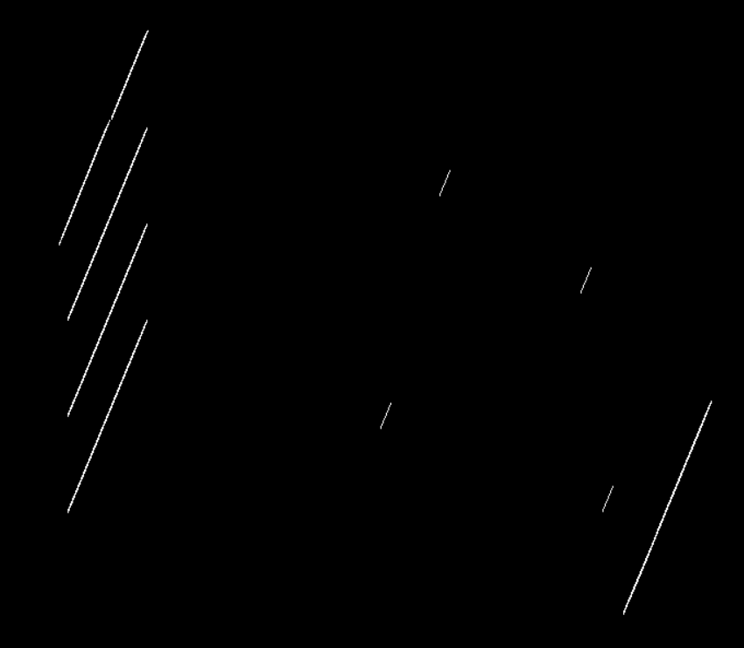
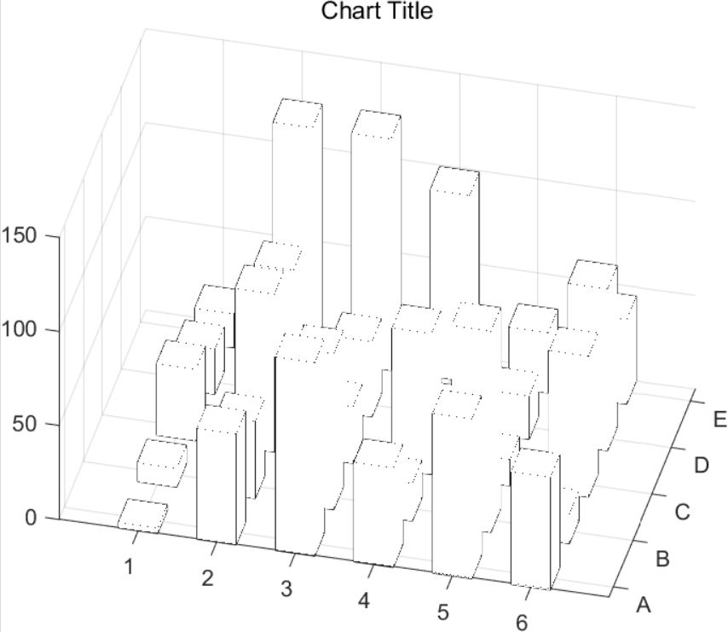
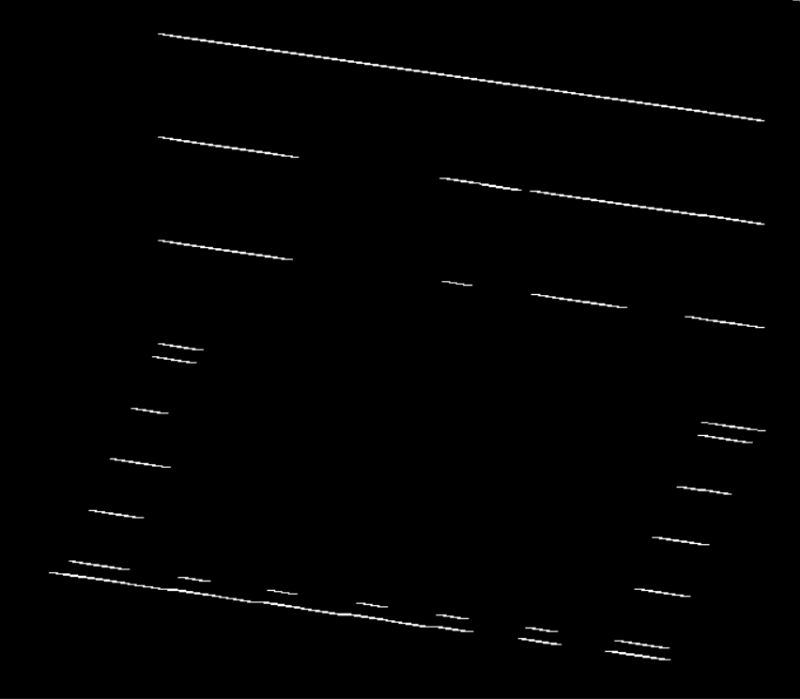
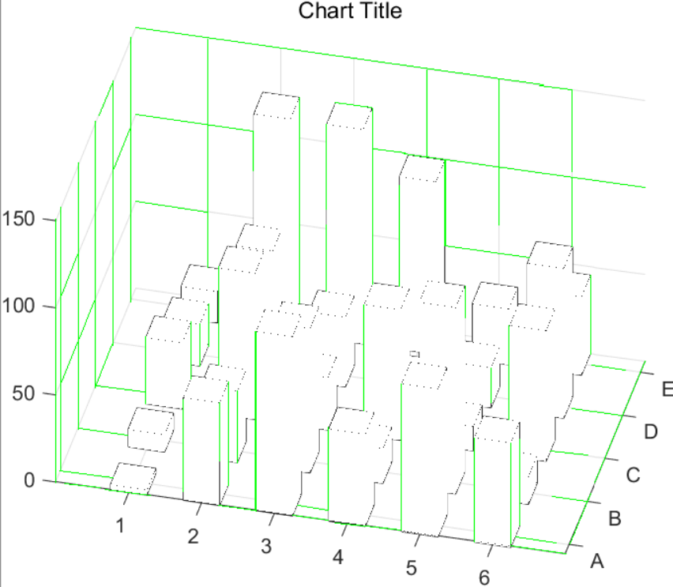
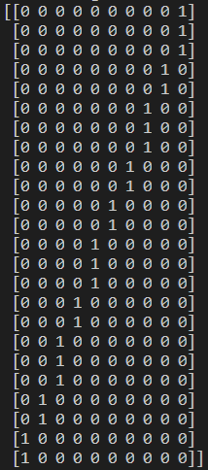
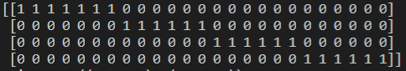
Find the axes
Algorithm
Remove color bars using HSV info
Find lines using Hough line transform
Find top 3 frequent degrees of the lines
Apply bitwise not operation
Make kernels using the found degrees and apply erode and dilate with them.
Find the start and end point of axis according to the degree
Degrees : 90, 68, -8
Notes:
This is the algorithm.
First it removes color bars using HSV information.
And apply Hough line transform to detect all lines in the picture.
Because the auxiliary lines are parallel to the axes, I could infer the degrees of the axes.
Then we could find top 3 frequent degrees of the lines. In this case, they were 90, 68 and -8.
After applying bitwise not operation, it makes kernels according to the inferred degrees.
By applying erode and dilate, I could leave only lines parallel to the inferred degrees.
Using those lines, it is easy to find the start and end point of axes.
The red lines on the picture indicate the found axes.

Slide 9
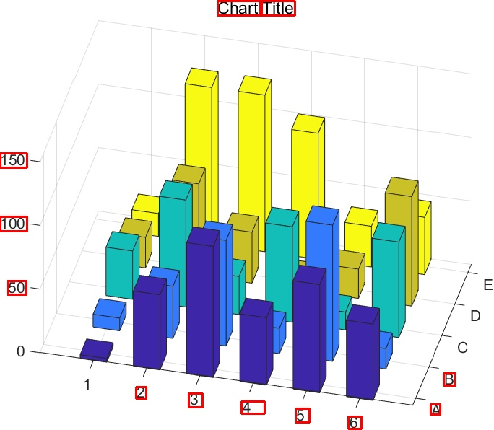

Read labels
Text box from CRAFT
Label information
- x = 55.0 ([55.0, 490.0]) -> ([55.0, 224.0])
- y = -2.41x + 1942.95 ([572.0, 563.0]) -> ([652.0, 370.0])
- y = 0.14x + 481.88 ([563.0, 562.0]) -> ([43.0, 488.0])
Axis information
Notes:
In order to understand the chart comprehensively and read real values from image pixels, we should be able to read labels from the chart.
This work requires text bounding box and axis information. Axis information used here is start and end point for each axis and
for bounding box, we adapted pretrained CRAFT engine which is made by naver clova ai team.
From these information this part outputs label values and pixel distance per tick for each axis.

Slide 10
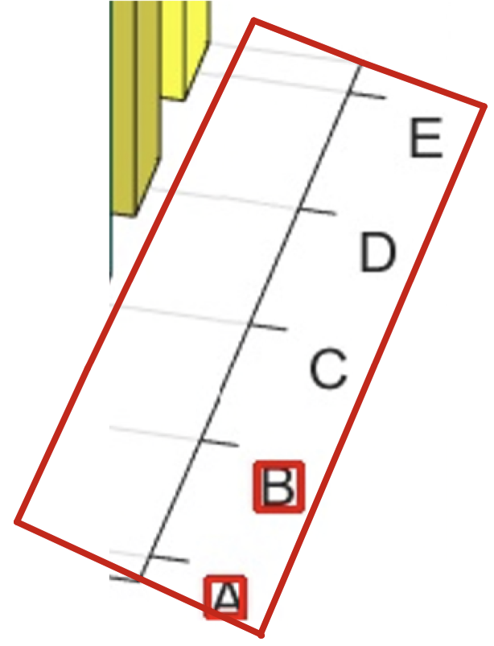
Read labels Algorithm - Detection
Find bounding boxes around the axis based on the distance
Estimate hidden boxes from delta
Notes:
The algorithm for reading labels composed of two parts.
The first one is about estimating hidden text boxes, since it is not guaranteed that CRAFT engine always detect them.
Here we set one assumption, which is there will be at least one sequential boxes detected, so that we know the pixel distance between ticks.
From this assumption, we simply look for positions by adding the delta from each box.

Slide 11
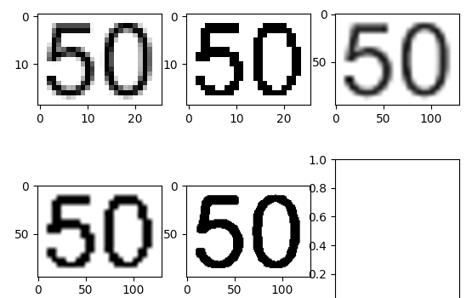
Read labels Algorithm - OCR
Run tesseract OCR engine
Original
Binarized by thresholding
5x resized - original
5x resized – binary
4 binarized again
Notes:
Secondly, we run OCR engine from open-source project called tesseract for the text boxes found before.
I tried 5 different images to increase accuracy. 1 is original, 2 is binarized by thresholding, 3 and 4 is 5 times upscaled image from 1, 2. 5 is binrized again

Slide 12
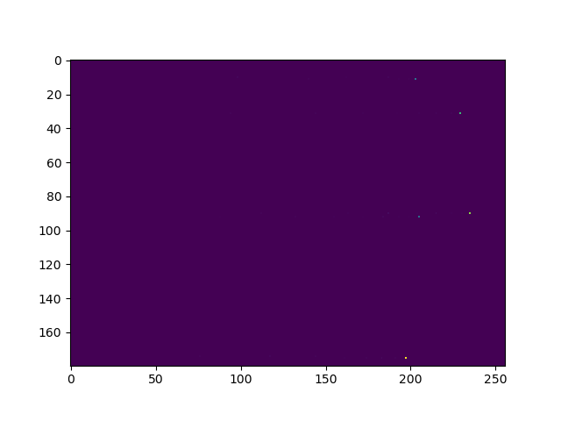
Separate series with HSV colors
Number of series : 5
H-S Histogram of 3D bar chart image
Notes:
Colors are very distinctive feature in 3d bar chart image. Chart images can be separated with HSV pixel value easly. Since this color extraction is robust, We find out how many numbers of color in the image. And number of colors indicate the number of series of the data.

Slide 13
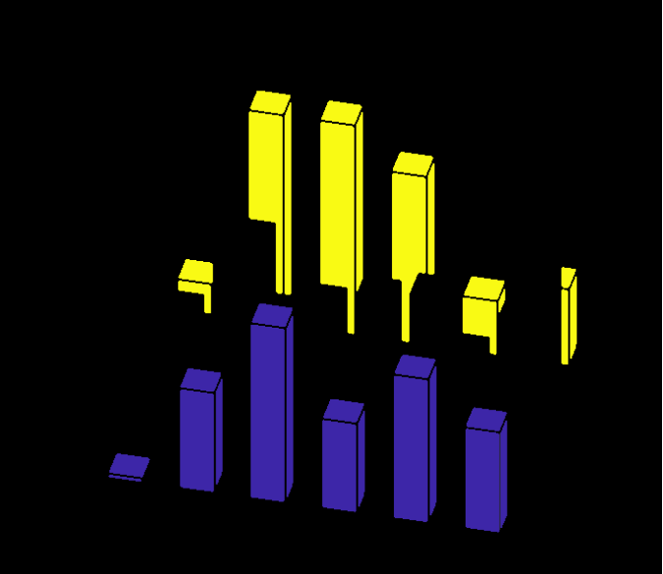
Separate series with HSV colors
Sorted in series order
Interval length between series
Notes:
Also from the divided chart image we found out the intervals between the series. We first, sorted the divided single bar images in series order. Then by subtracting most bottom pixel location of front series and that of last series, we can evaluate the interval between series.

Slide 14

Head Definition
To read data from the bar,
Humans first find the top face of each bar
Head $≡$ the top face of each bar
Notes:
What is head? Let’s think about how humans read the 3D bar chart. Humans first find the top face of each bar and move it parallely along the x or y axes because the z-value of the top face denotes the data value. So we define the top face of each bar as a head. In this program, the algorithm is going to detect and match the heads to get information of each bar.

Slide 15
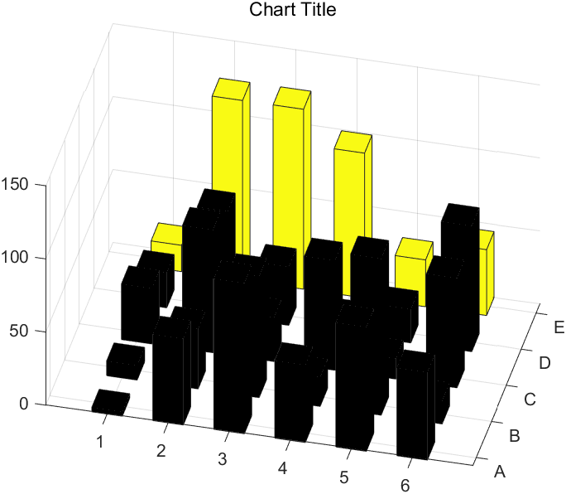
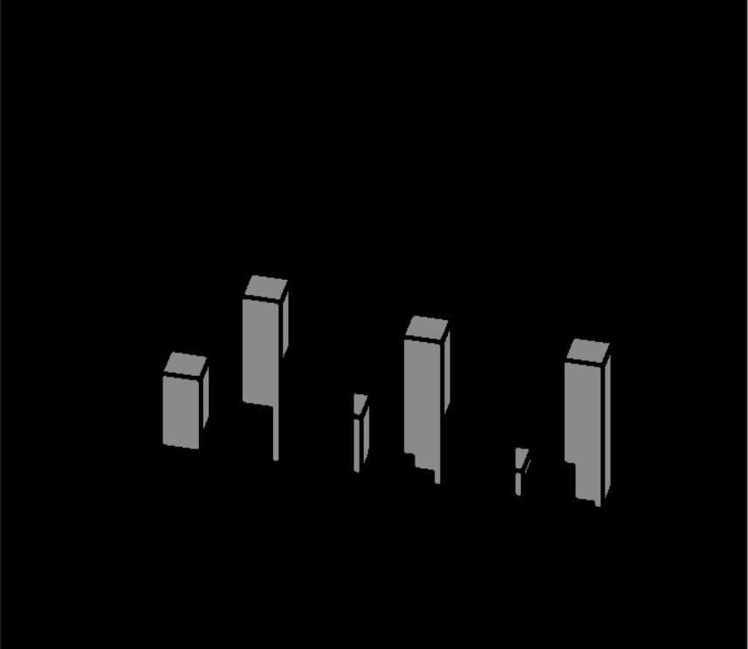
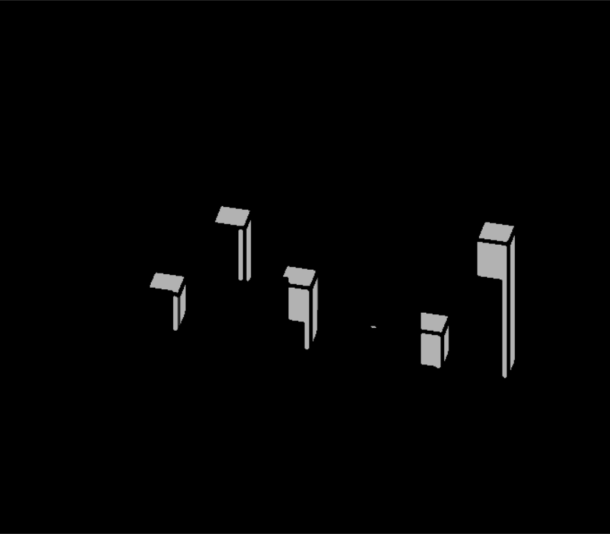

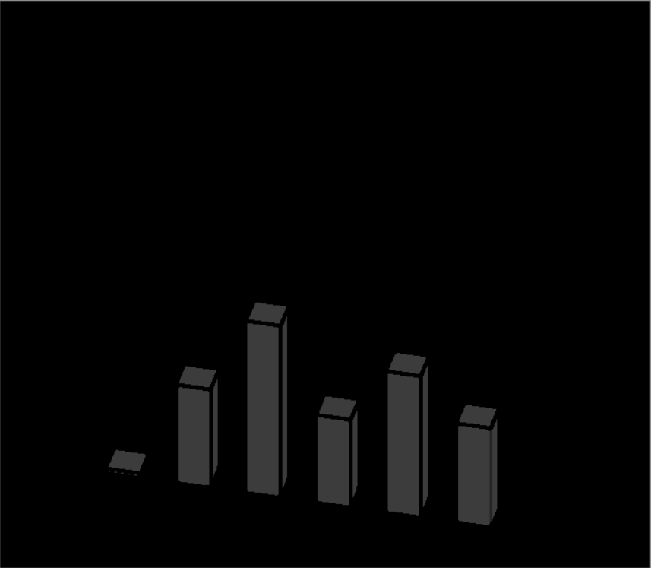
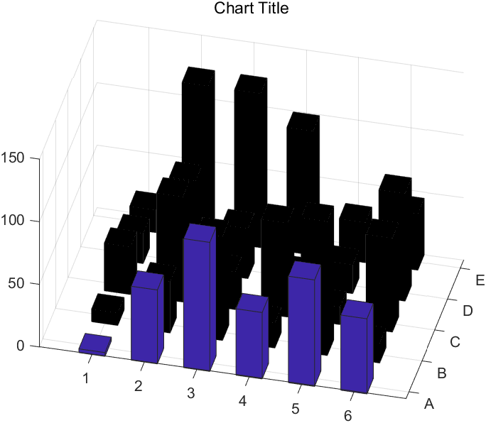
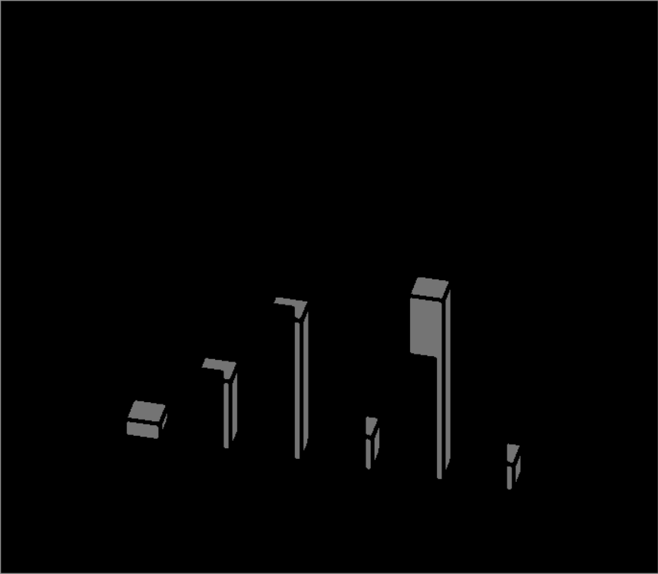
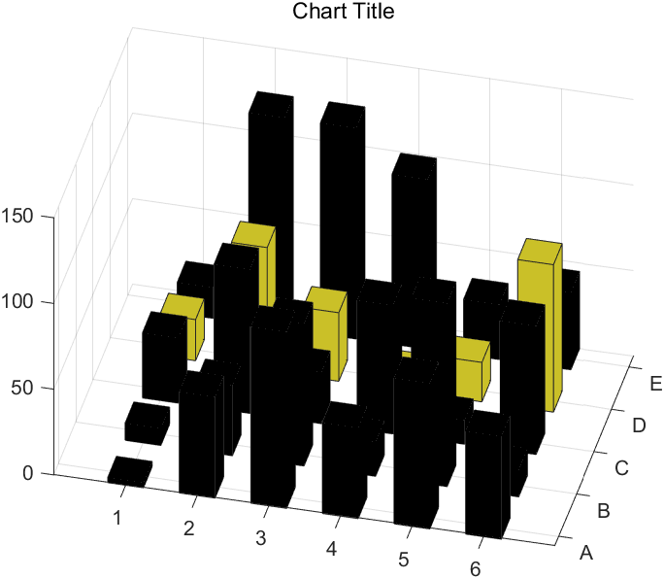
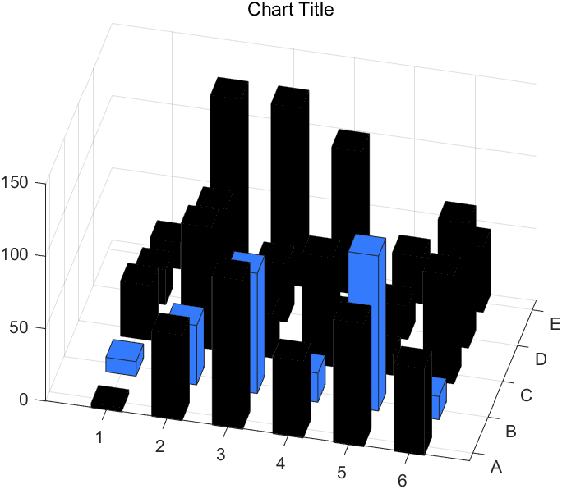
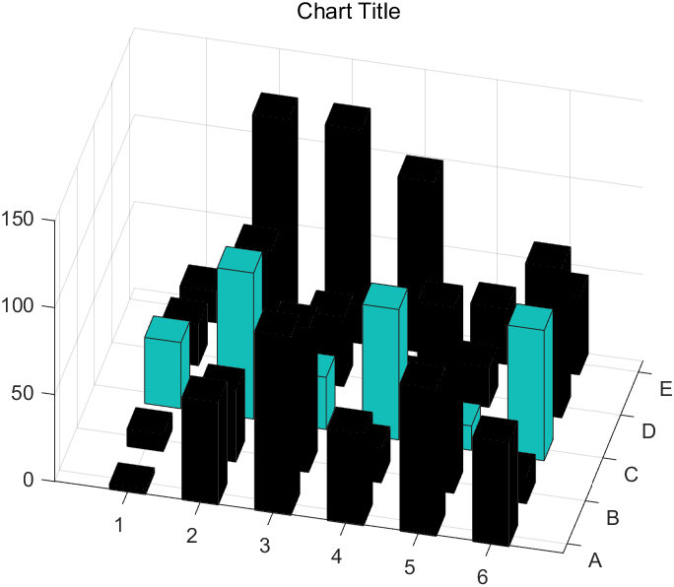
Head Detection
Find the upper most head.
Save the detected head image as a template.
Fix occluded head to normal head!
Notes:
First is, head detection. In the previous step, we get the images of each separated color. Using this image, find the upper most head of each color. I’ll explain how. First, convert the separated color images as grayscale images. Then, with the assumption that the head is separated (from the bar it belongs) by black lines, find the upper most head of each color. If the upper most head is partly occluded, this algorithm compares the head size with other colors and automatically fix the occluded head image to normal head image. Then, save the detected head image as a template which will be used in next step.

Slide 16
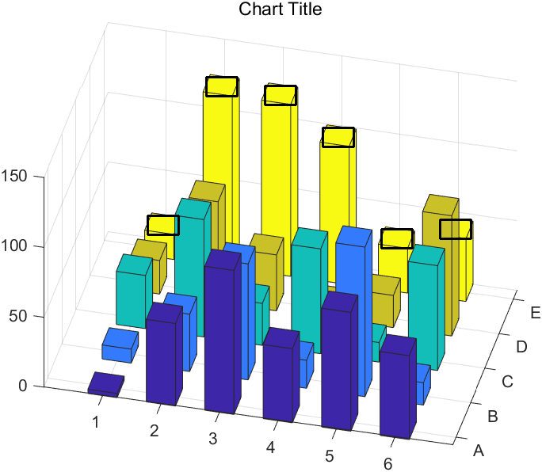
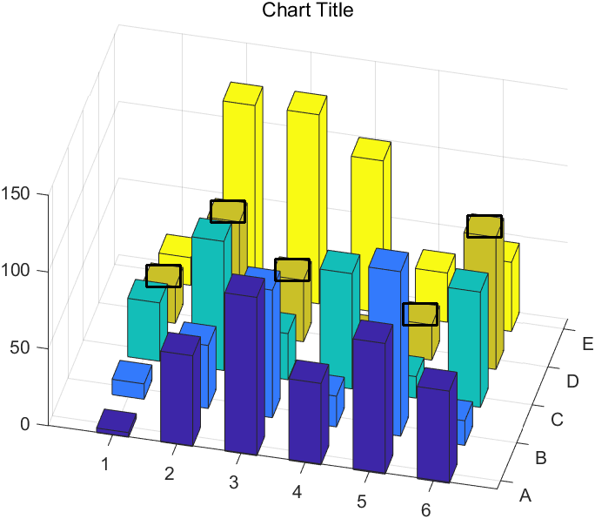



Head Matching
Template(head) Matching
-Calculate the interval between the bars.
-Only leave the most similar part in interval.
-Even detect the partially occluded heads!
Save the coordinates
Notes:
In this step, we use the head image as a template. Using template matching in OpenCV, we find which part of the chart image corresponds with the head image of each color. This algorithm automatically calculates the interval between the bars. Algorithm iterates until it finds the matching parts within the interval and only leaves the most similar part within the interval. This increases accuracy of matching and reduces the running time. This algorithm can even detect the occluded heads as above. Then, save the coordinates of the matched parts.

Slide 17
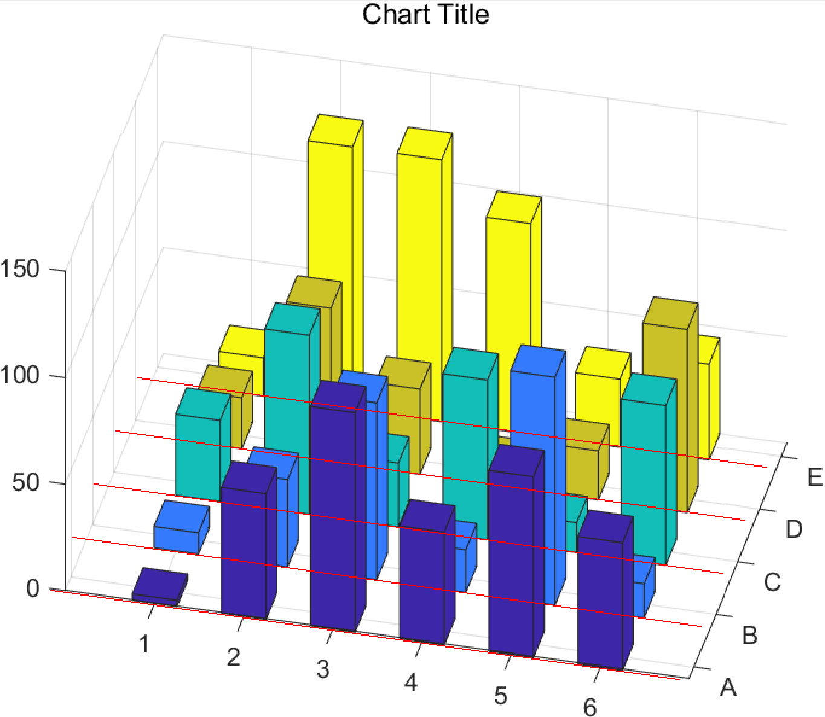
Data Extraction
1. Draw the bottom lines
2. Distance between a head and its bottom line
3. Extract data value
Notes:
Combining the axes, labels, and head coordinates information, extract the data values.
First, draw the bottom lines parallel to x and y axes.
Second, calculate the distance between a head and its corresponding bottom line.
Third, combining the distance and labels information, we can extract the data value of each head.
Finally, compare it with the the true value. In this way, we can evaluate the accuracy of the data we extracted.

Slide 18
Data Extraction - Result
Notes:
As a result, we could acquire values for each bar as the figure. Now, we are going to show you a live demo of what we’ve done.

Slide 19
Live Demo
Let's see our Live demo!
Notes:
Combining the axes, labels, and head coordinates information, extract the data values.
First, draw the bottom lines parallel to x and y axes.
Second, calculate the distance between a head and its corresponding bottom line.
Third, combining the distance and labels information, we can extract the data value of each head.
Finally, compare it with the the true value. In this way, we can evaluate the accuracy of the data we extracted.

Slide 20
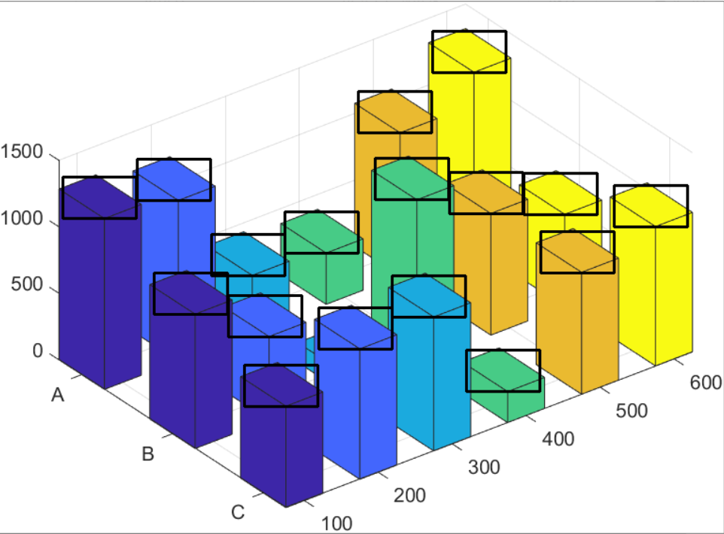
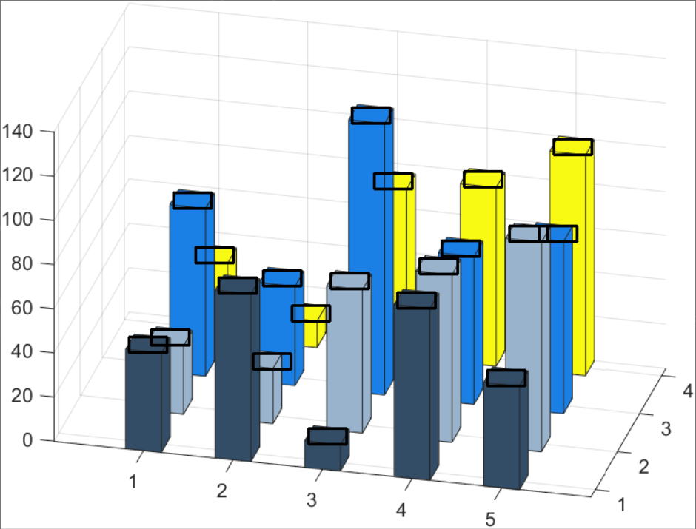
Data Extraction - Result
Error rate: below 5%
(5 images / total 15 images)
Notes:
As a result, we could acquire values for each bar as the figure. Now, we are going to show you a live demo of what we’ve done.

Slide 21
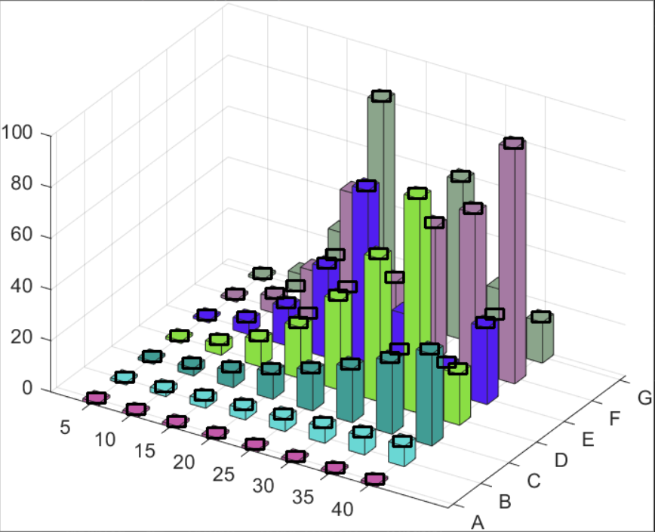

Data Extraction - Result
Error rate: over 5%
(7 images / total 15 images)
Notes:
As a result, we could acquire values for each bar as the figure. Now, we are going to show you a live demo of what we’ve done.

Slide 22

Data Extraction - Result
Error in detection
(3 images / total 15 images)
Notes:
As a result, we could acquire values for each bar as the figure. Now, we are going to show you a live demo of what we’ve done.

Slide 23
Conclusion
Only succeeded for some charts.
Few more improvements can be made.
Possibilities for expanding the datasets.
Notes:
Although we've set several assumptions, we succeeded to create a perfect result for some charts. We expect a few more improvements such as robustness of text recognition and occluded bars. We also leave some possibilities for expanding the datasets beyond Matlab charts.

